Slide 1
Capacity Constraints Across Nests in Assortment Optimization under the Nested Logit Model
Jake Feldman
Cornell University
School of ORIE
Huseyin Topaloglu
Cornell University
School of ORIE

Slide 2

Problem Basics

Slide 3
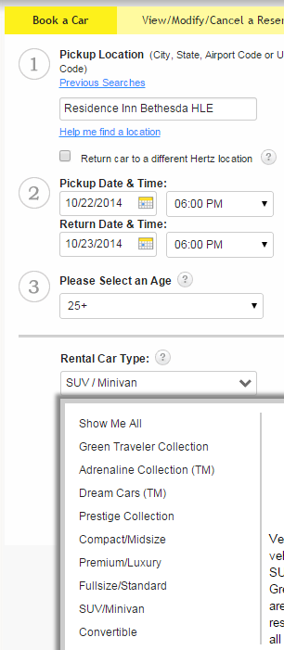
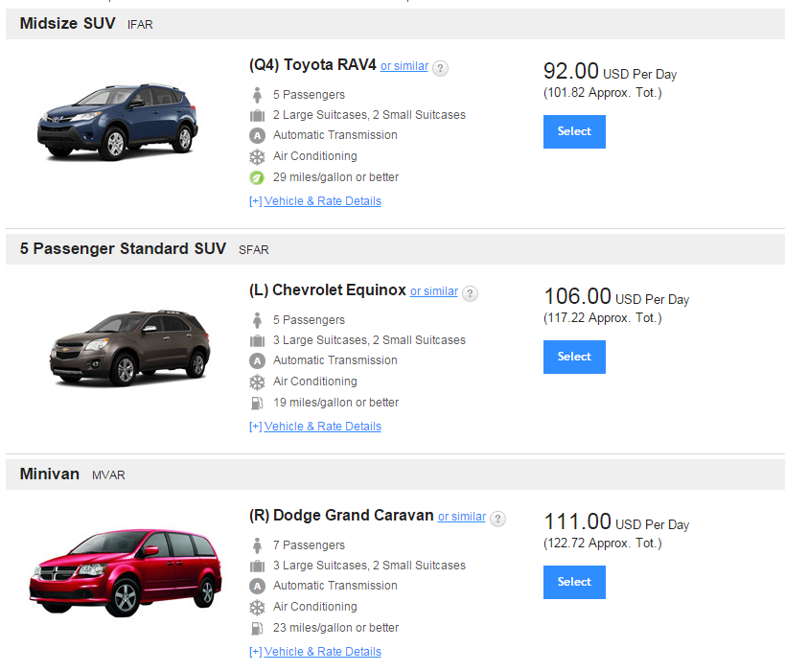
Renting a Car

Slide 4



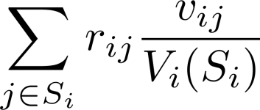





Nested Logit Model

Slide 5








Nested Logit Model

Slide 6

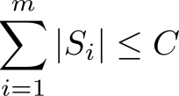
Nested Logit Model

Slide 7


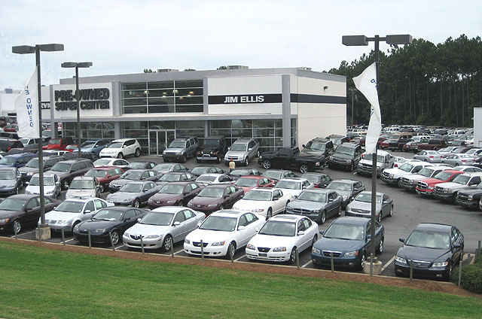
Background

Slide 8



Background

Slide 9










Solution Approach

Slide 10


Difficulties

Slide 11





Bisection on Z

Slide 12

Difficulties

Slide 13
Difficulties

Slide 14












Reducing Number of Candidate Assortments

Slide 15
Difficulties

Slide 16




Stringing Candidate Assortments Together

Slide 17

Difficulties

Slide 18








Putting Everything Together

Slide 19



Summary

