Slide 1
Revenue Management under a Markov Chain Based Choice Model
Jake Feldman
Cornell University
School of ORIE
Huseyin Topaloglu
Cornell University
School of ORIE

Slide 2
Problem Description

Slide 3
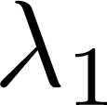
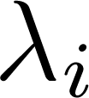
Markov Chain Based Choice Model

Slide 4
Purchasing Dynamics

Slide 5
Purchasing Dynamics

Slide 6
Purchase Probabilities

Slide 7
Purchase Probabilities

Slide 8
Purchase Probabilities

Slide 9
Motivating the MC Based Choice Model

Slide 10
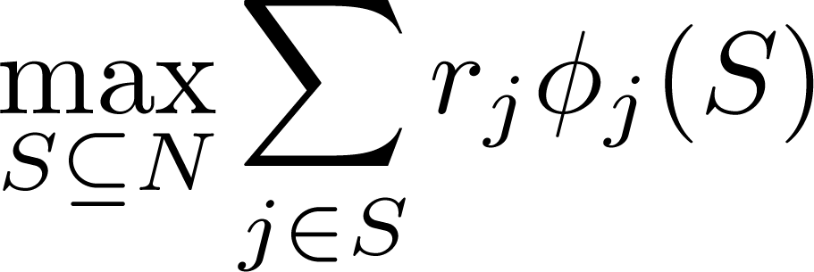
Static Assortment Optimization

Slide 11
Static Assortment Optimization

Slide 12
Static Assortment Optimization

Slide 13
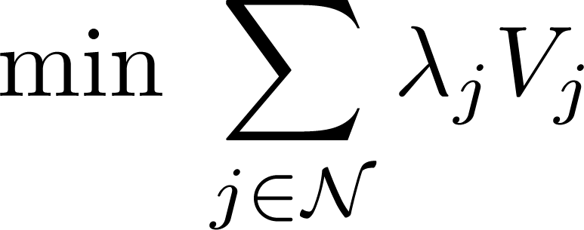
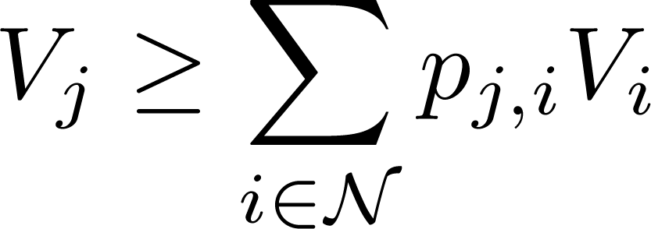
Static Assortment Optimization

Slide 14
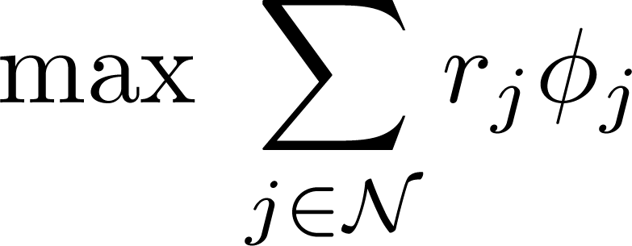
Static Assortment Optimization

Slide 15
Novel LP Formulation

Slide 16
Novel LP Formulation

Slide 17
Property of Extreme Point

Slide 18
Property of Extreme Points

Slide 19
Property of Extreme Points

Slide 20
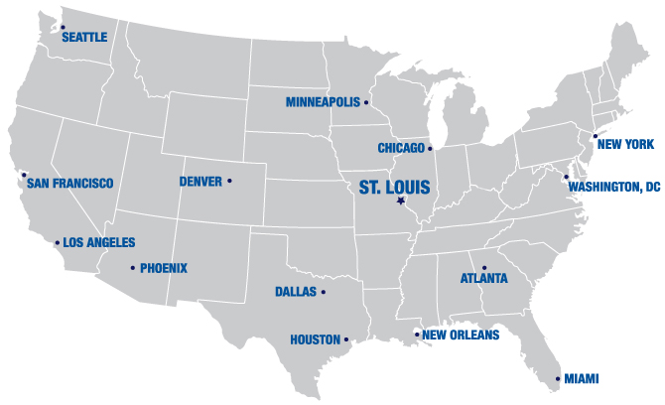
Network Revenue Management

Slide 21
Network Revenue Management

Slide 22
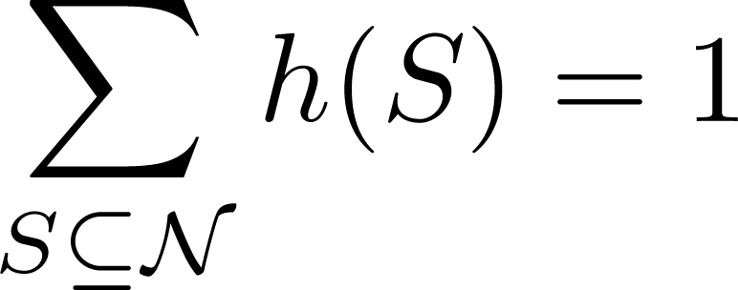
Deterministic Linear Program

Slide 23
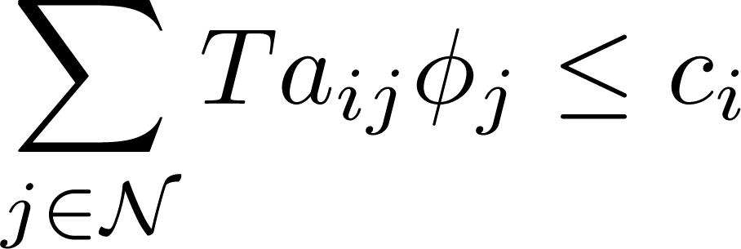
Reduced Deterministic Linear Program

Slide 24
Finding a Policy

Slide 25
Recovering DLP Solution

Slide 26
Recovering DLP Solution

Slide 27
Recovering DLP Solution

Slide 28
Recovering DLP Solution

Slide 29
Recovering DLP Solution

Slide 30
Recovering DLP Solution

Slide 31
Recovering DLP Solution

Slide 32
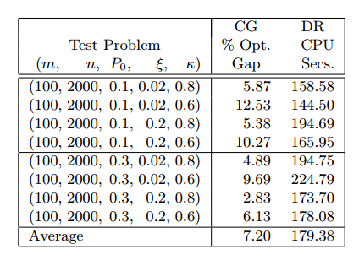
Computational Experiments

Slide 33
Thank you

