Slide 1
Upper Bounds on the Optimal Expected Revenue for Assortment Optimization under the Mixed Multinomal Logit Choice Model
Jake Feldman
Cornell University
School of ORIE
Huseyin Topaloglu
Cornell University
School of ORIE

Slide 2

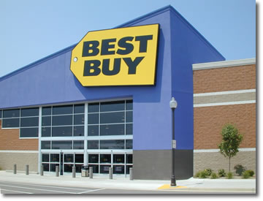

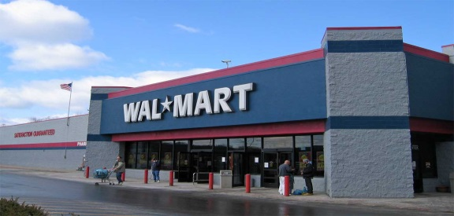

Problem Basics

Slide 3
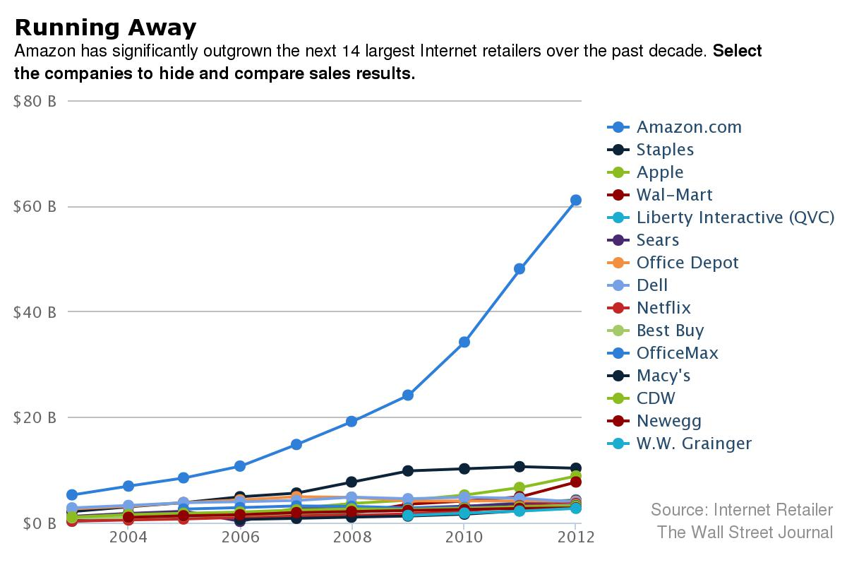
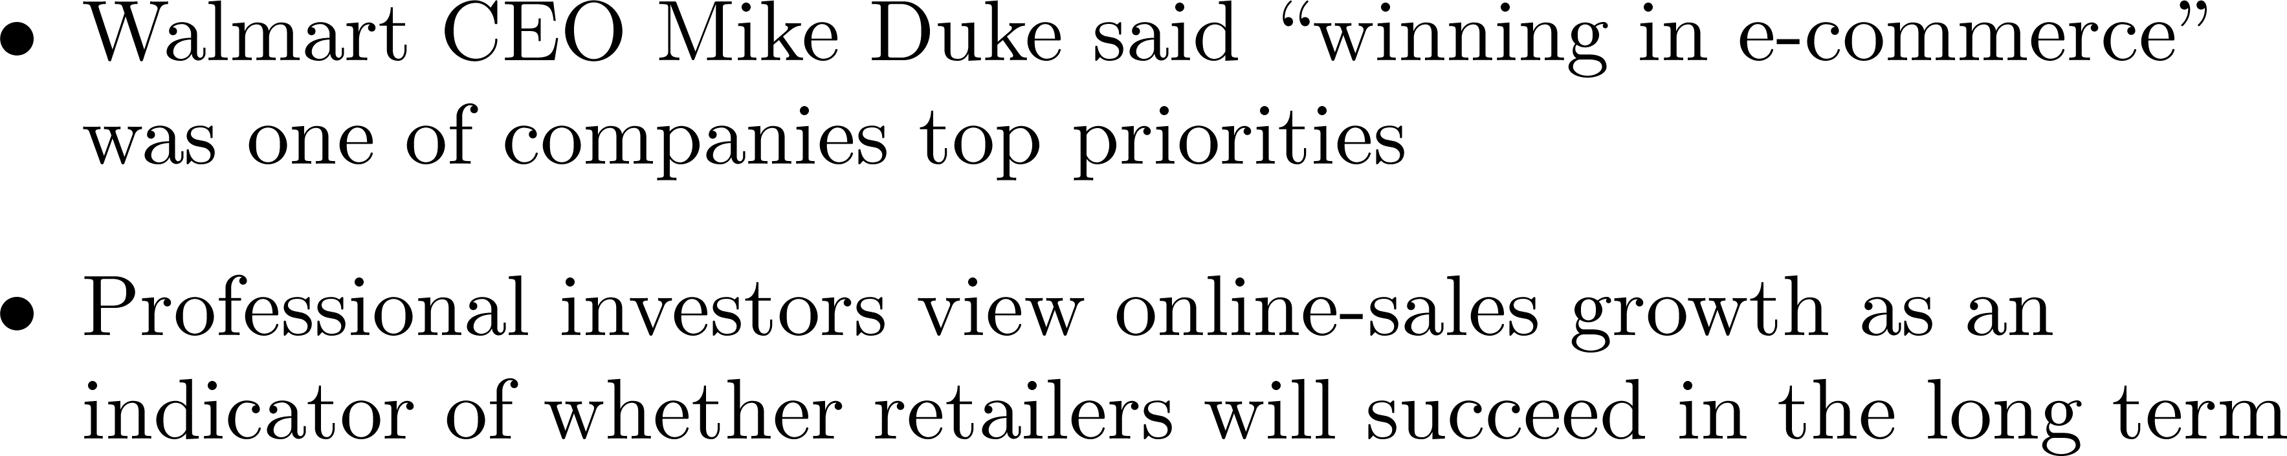
Motivation

Slide 4
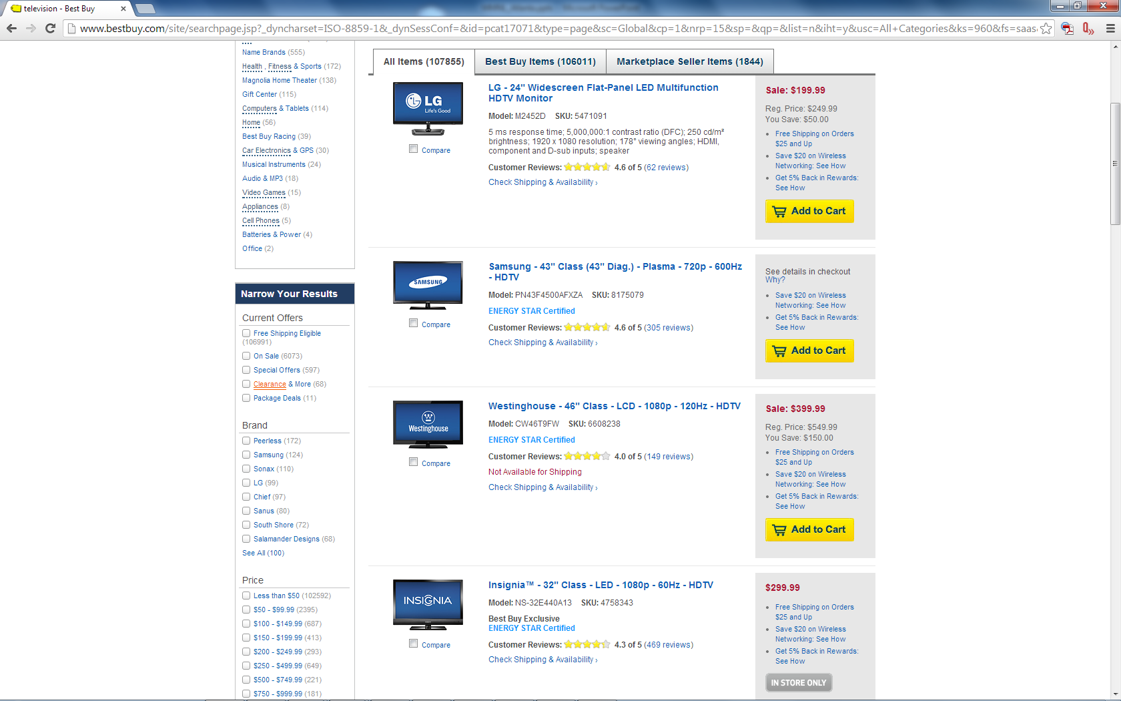
BestBuy.com – Purchasing T.V.

Slide 5
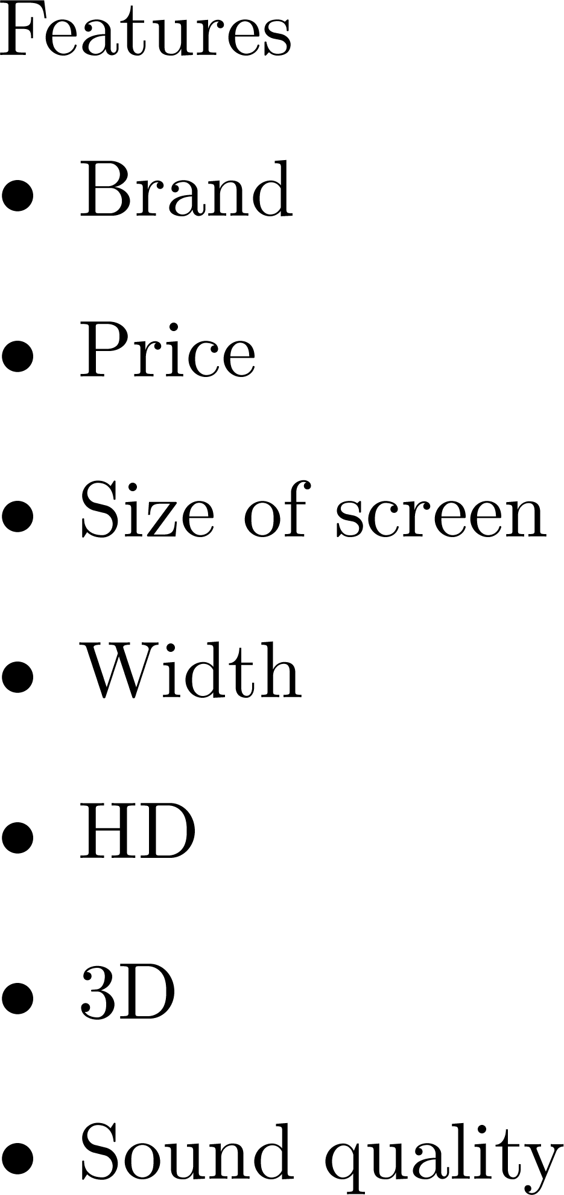
Modeling Customer Choice
Modeling Choice
Types of Shoppers

Slide 6
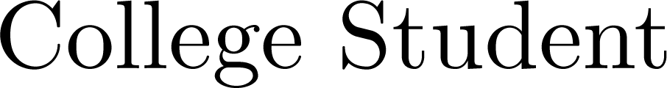

Modeling Customer Choice
Modeling Choice
Types of Shoppers

Slide 7


Modeling Customer Choice
Modeling Choice
Types of Shoppers
Types of Shoppers

Slide 8
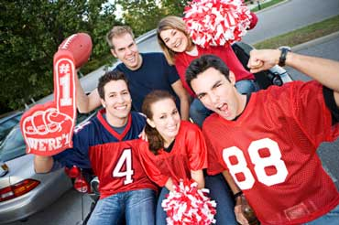
Modeling Customer Choice
Types of Shoppers

Slide 9
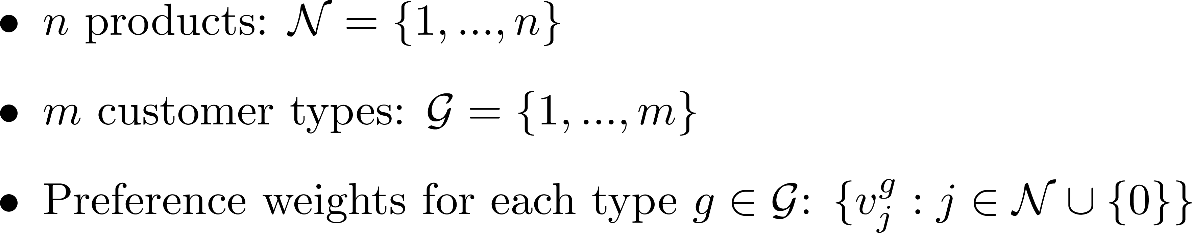


Parameters of Choice Model

Slide 10
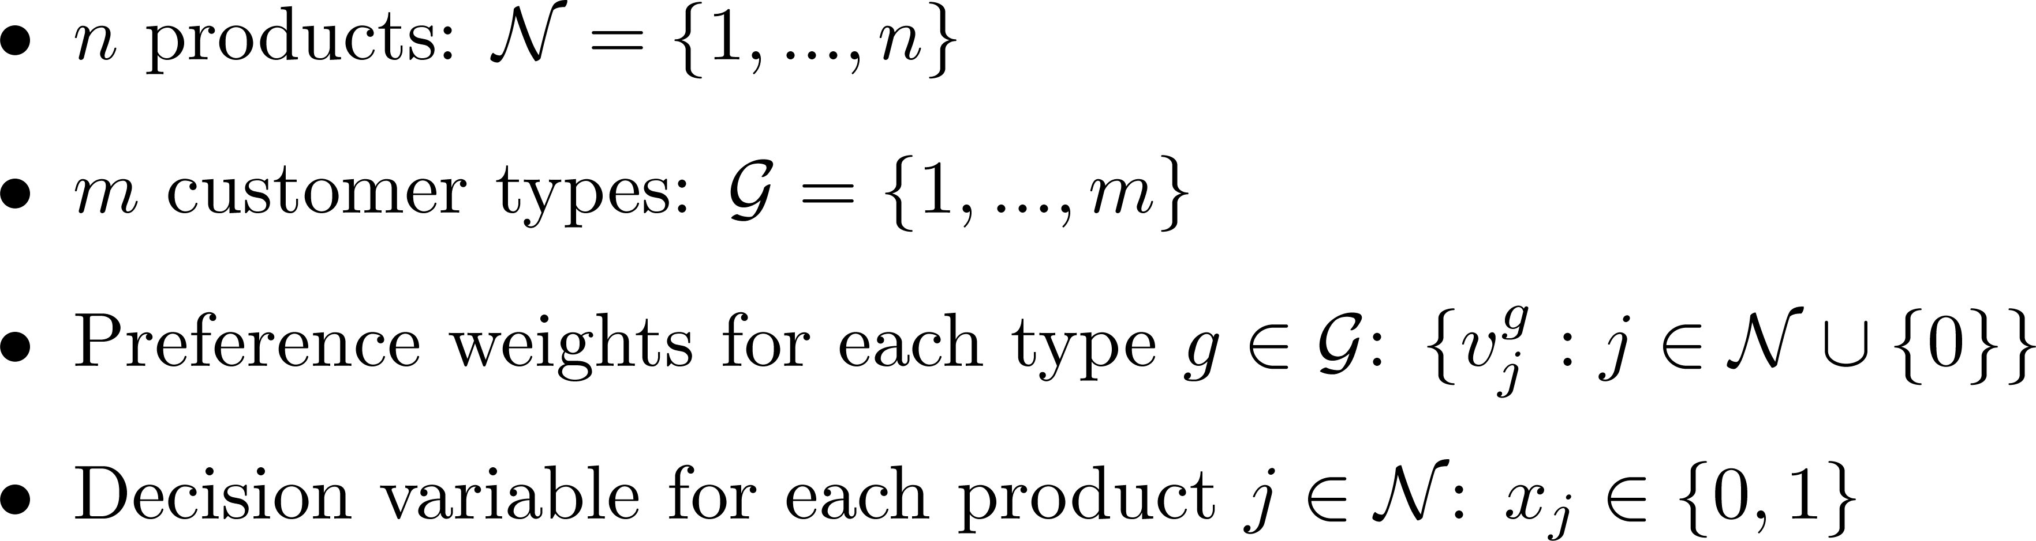
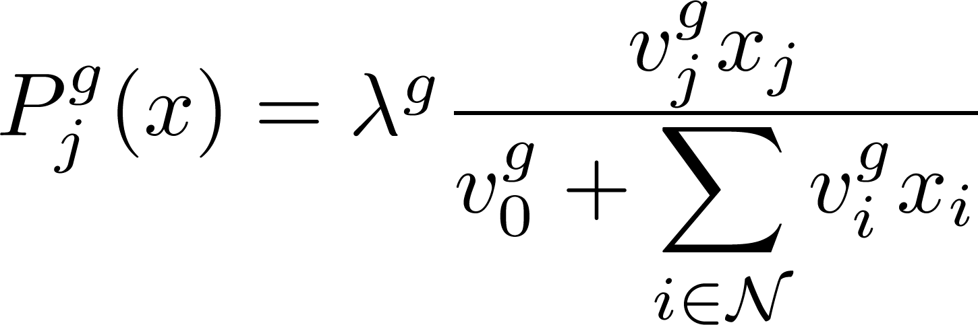
Mixed-Multinomial Logit Choice Model

Slide 11
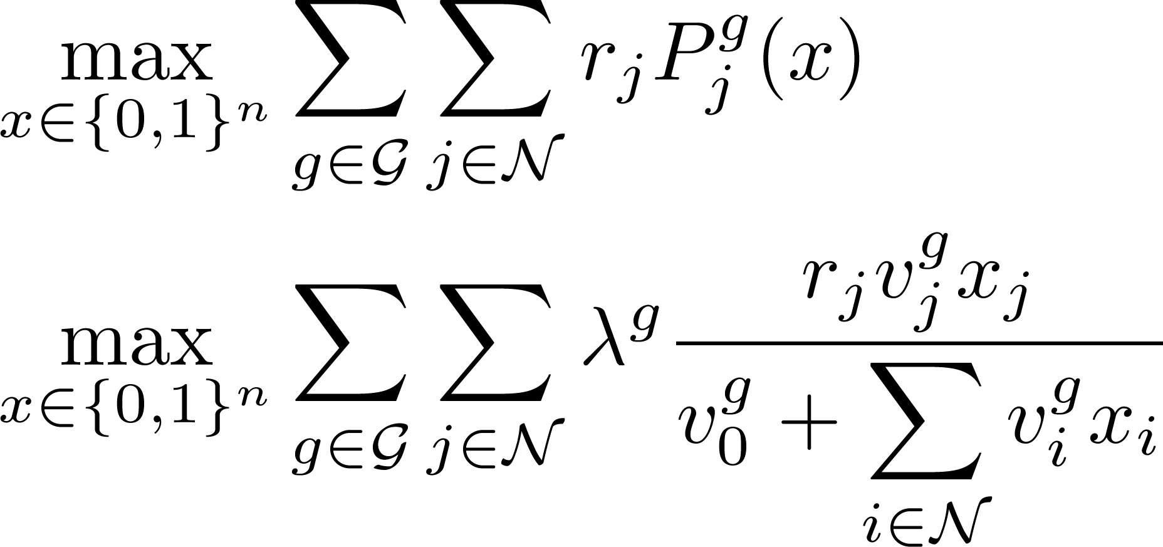
Problem Formulation

Slide 12
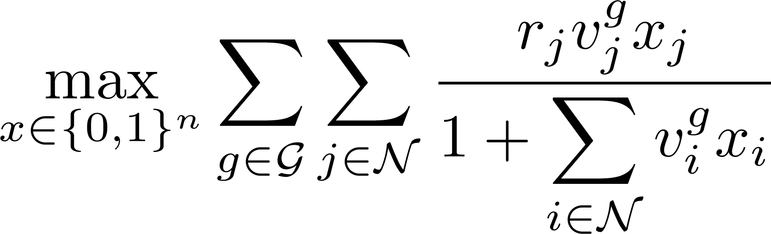
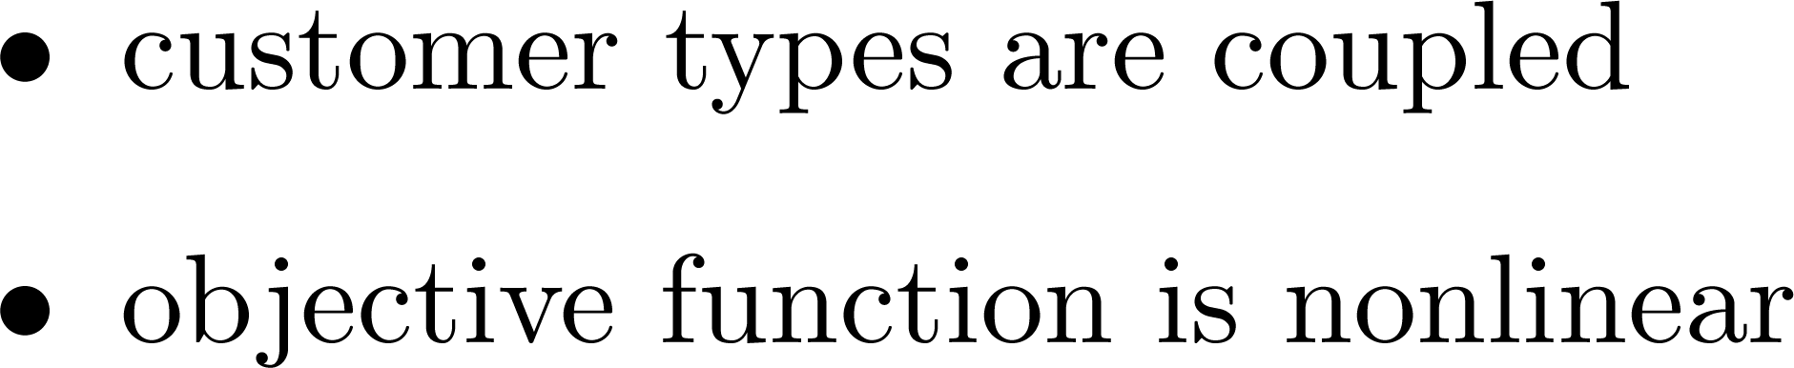
Problem Difficulties

Slide 13
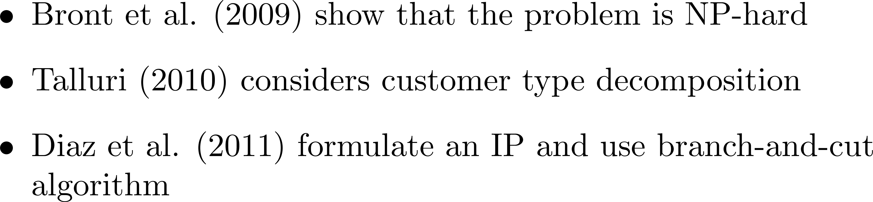
Background

Slide 14



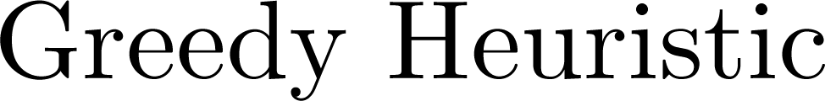
Upper Bound Approach

Slide 15
Decoupling Customer Types

Slide 16
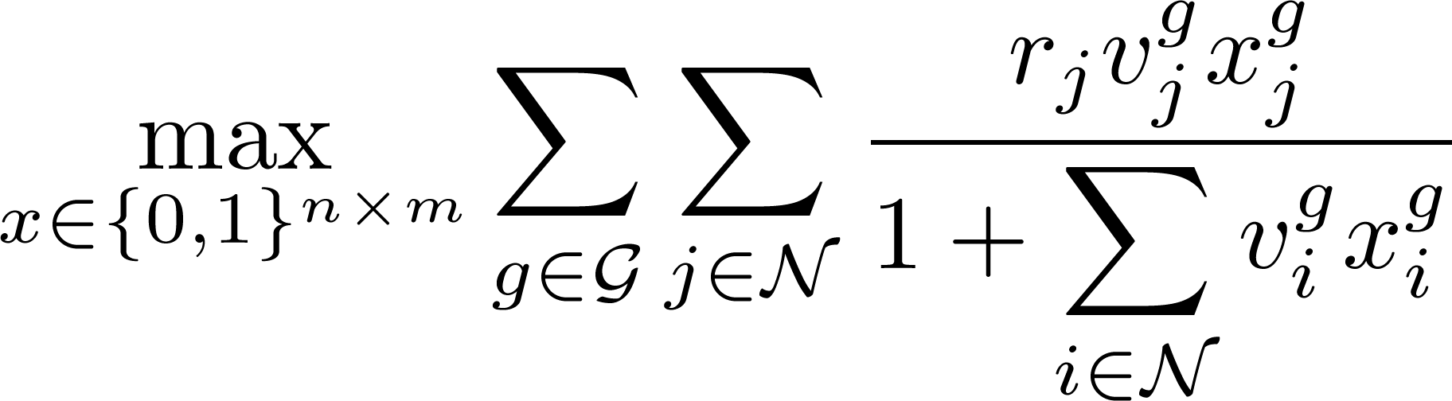
Decoupling Customer Types

Slide 17


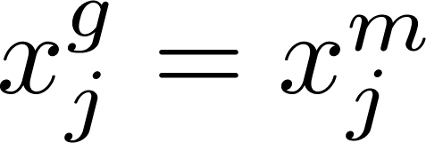
Decoupling Customer Types

Slide 18
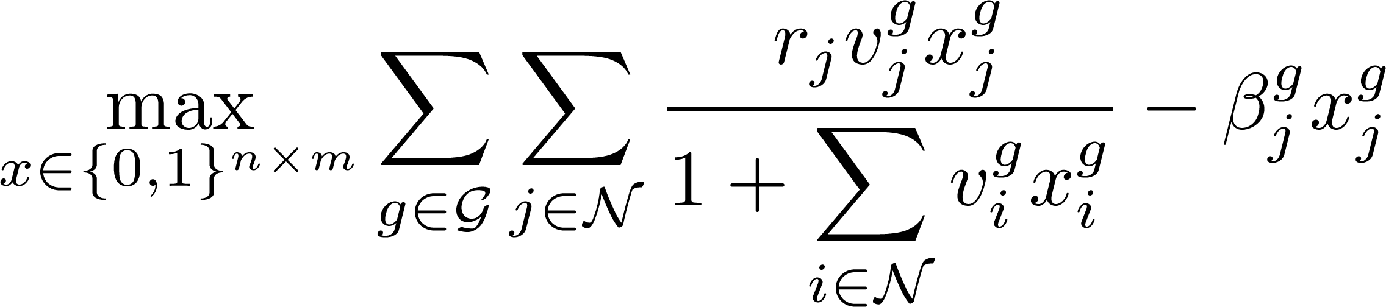
Decoupling Customer Types

Slide 19
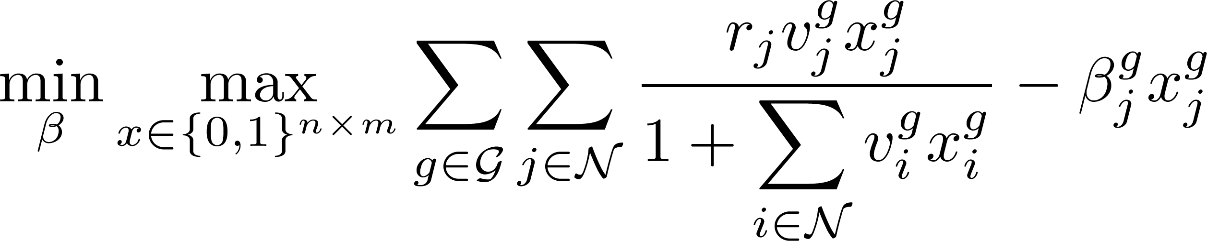
Decoupling Customer Types

Slide 20
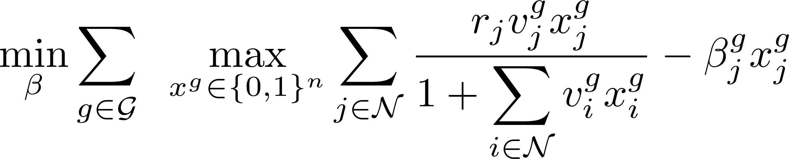
Remaining Difficulties

Slide 21
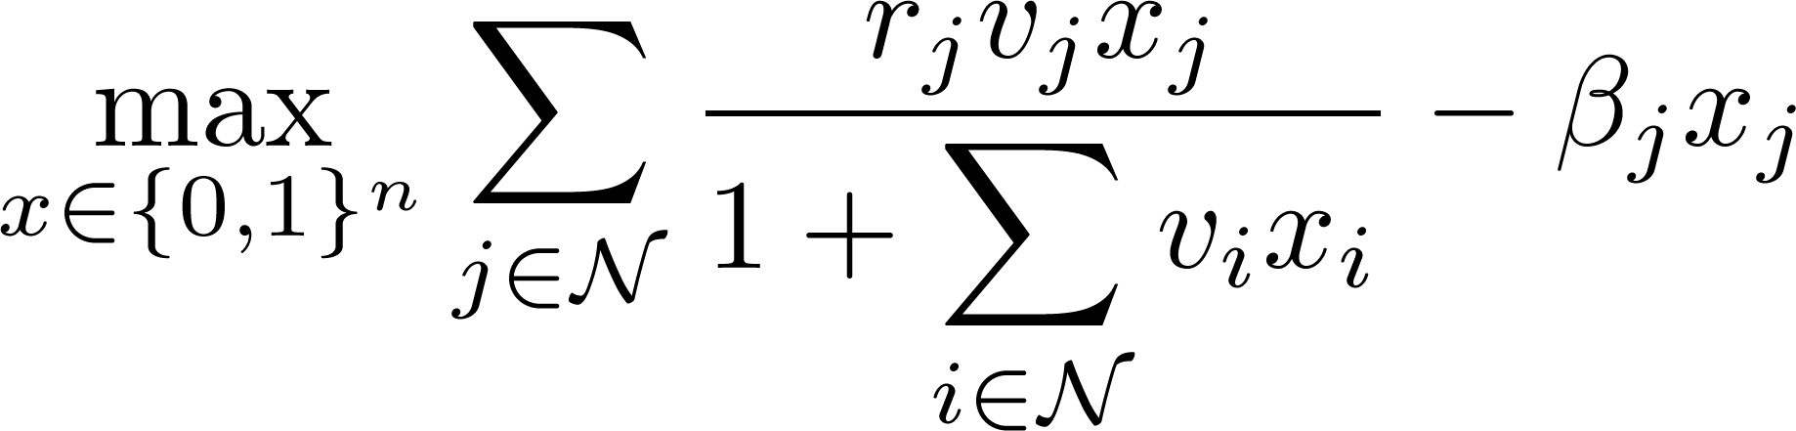
Side-Stepping Nonlinearity

Slide 22
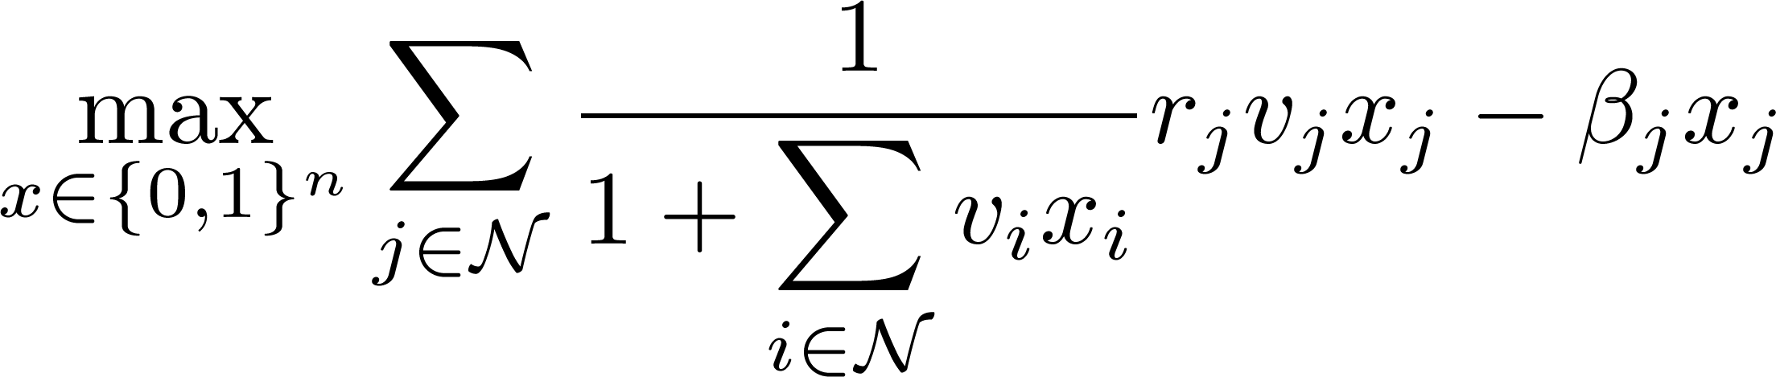
Side-Stepping Nonlinearity

Slide 23
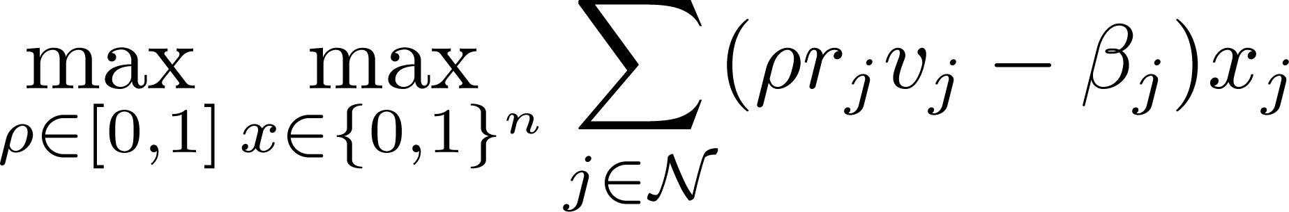
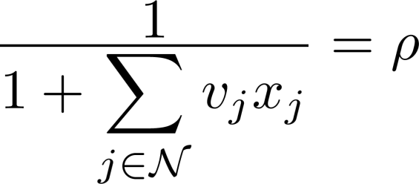
Side-Stepping Nonlinearity

Slide 24
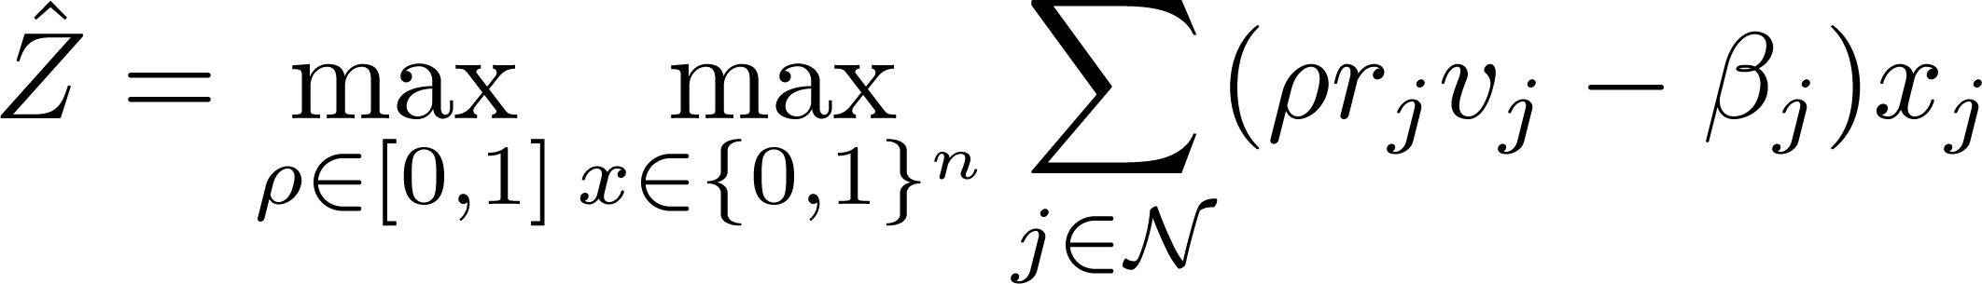
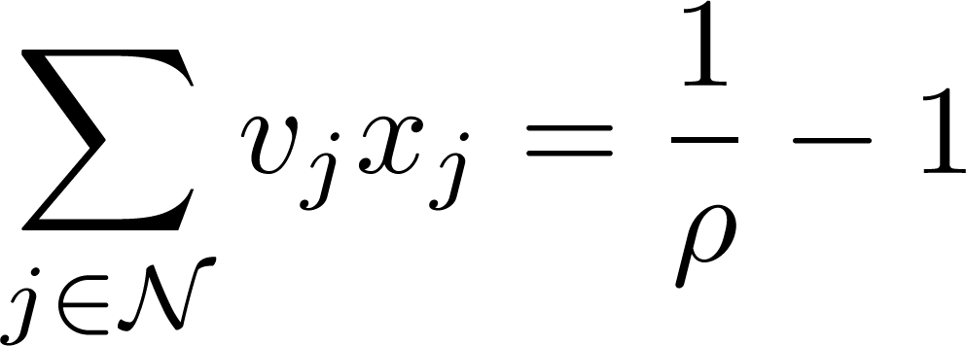
Side-Stepping Nonlinearity

Slide 25





Gridding No-purchase Probability

Slide 26
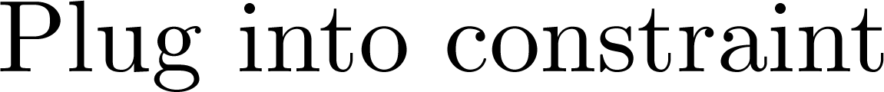
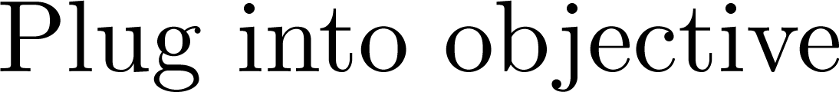
Gridding No-purchase Probability

Slide 27
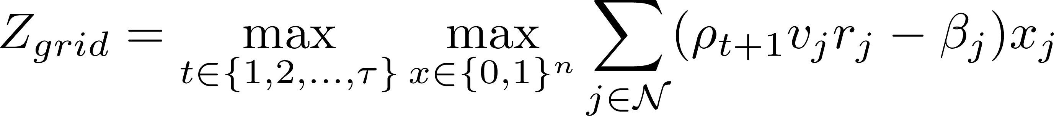
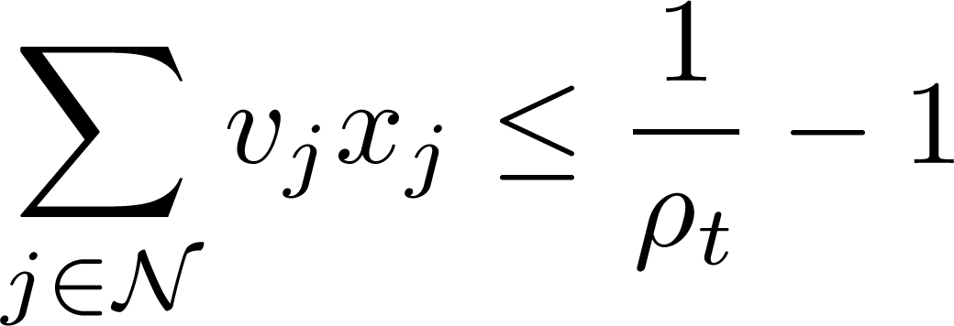
Maintain Upper Bound

Slide 28
Maintain Upper Bound

Slide 29
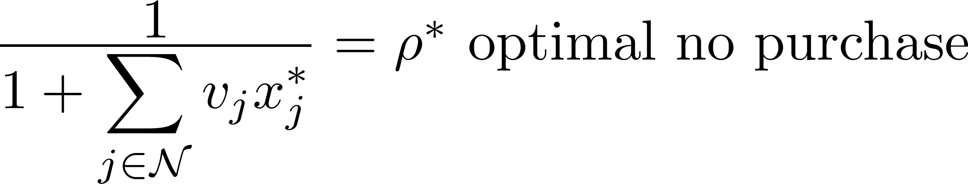
Maintain Upper Bound

Slide 30
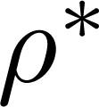
Maintain Upper Bound

Slide 31
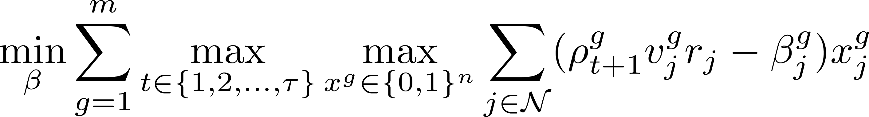

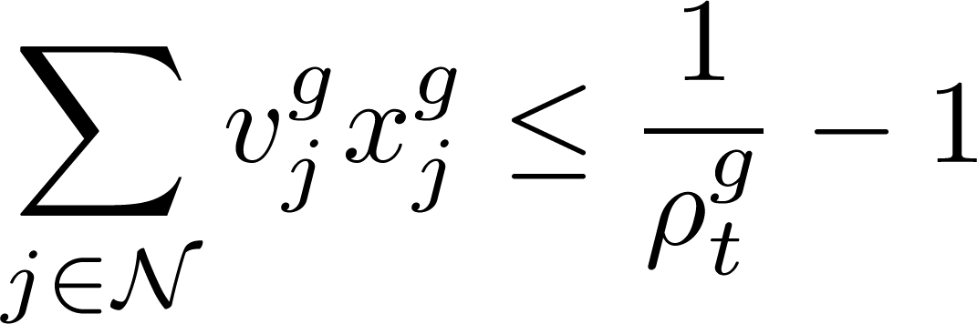
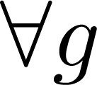
Full Problem

Slide 32
Full Problem

Slide 33

Full Problem

Slide 34
Full Problem

Slide 35
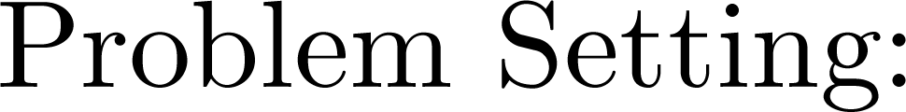
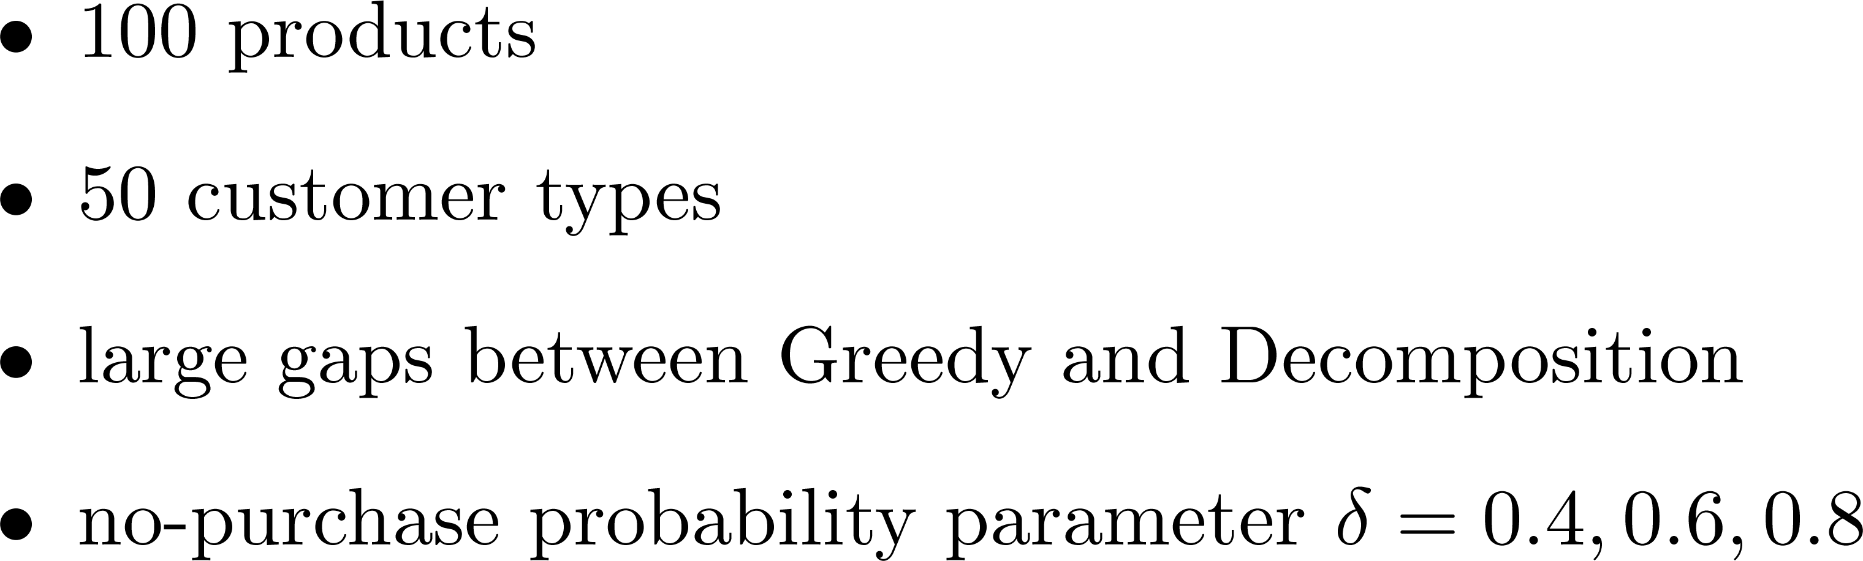
Computational Experiments

Slide 36


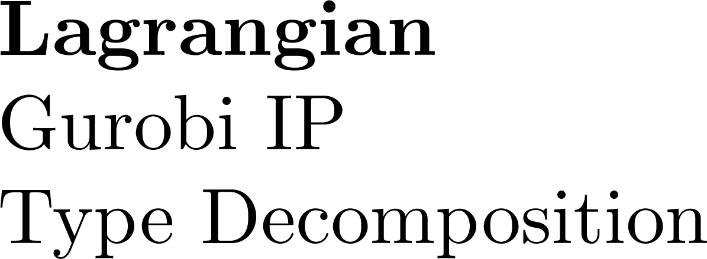
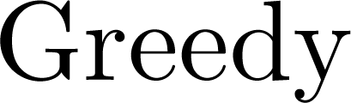

Computational Experiments

Slide 37

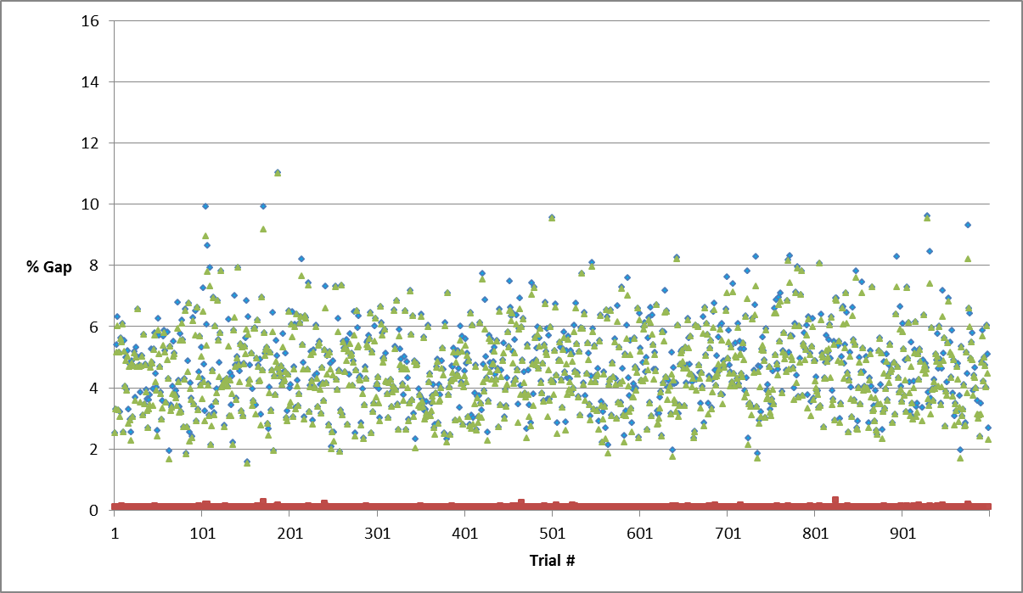
Results
Gurobi
CTD
Lagrangian

Slide 38

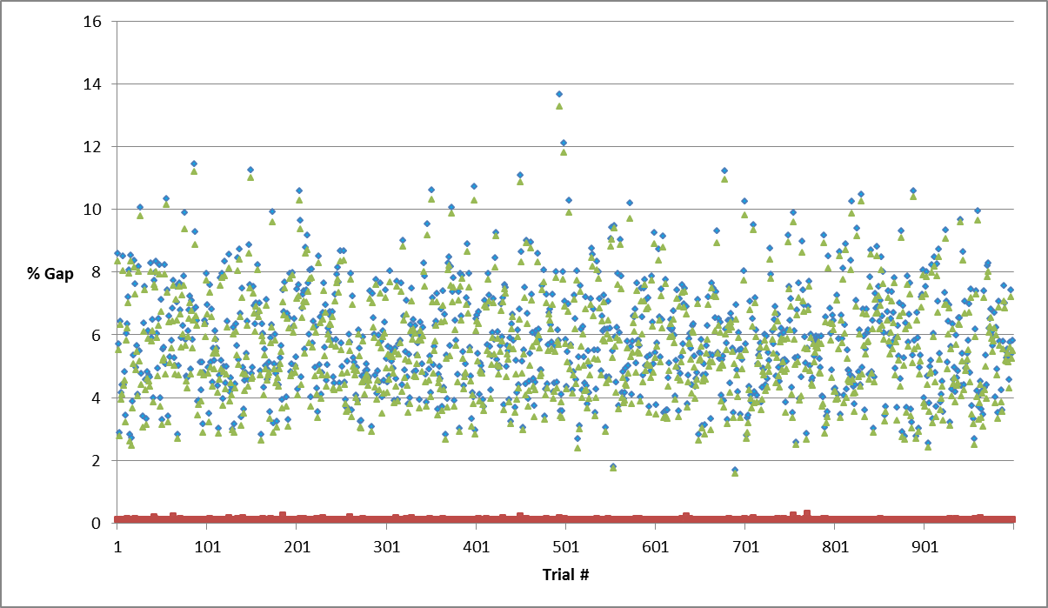
Results
Gurobi
CTD
Lagrangian

Slide 39

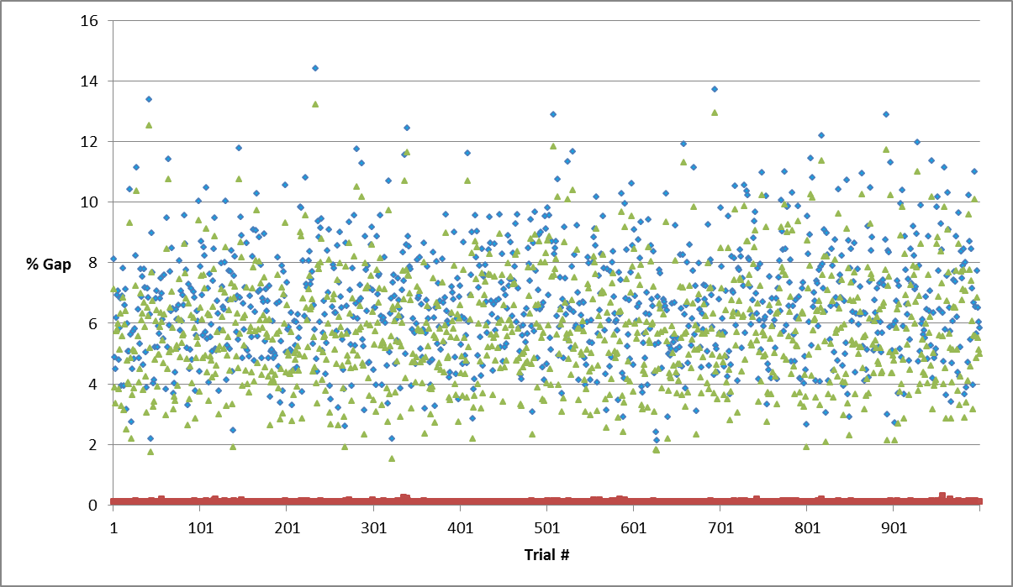
Results
Gurobi
CTD
Lagrangian

Slide 40
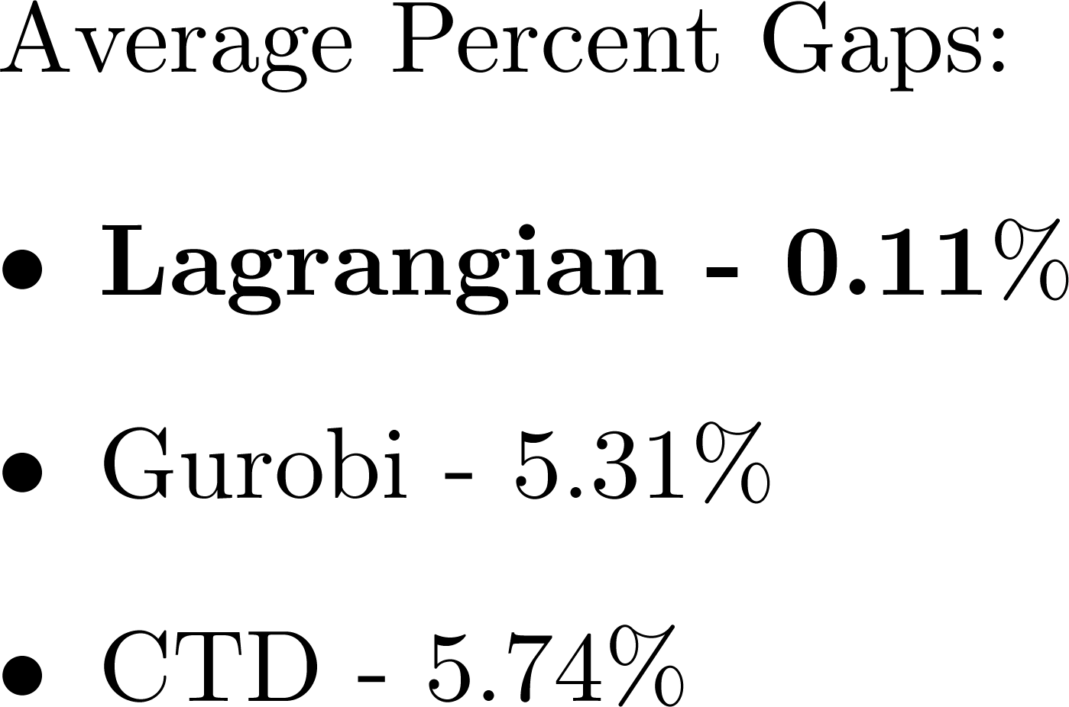
Summary of Results

Slide 41
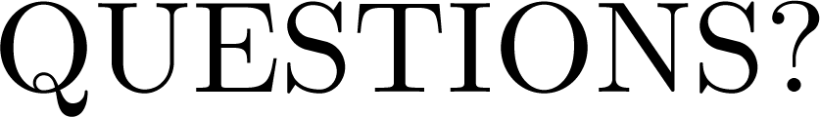
Thank you

